Slide 1
Revision-first part fundamentals of AI(comp1037)
Dr Qian Zhang and Dr Xinan Chen
Spring 2026

Slide 2

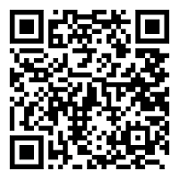


SET / sem
Target completion rate 50%
Strongly Agree = >
https://bluecastle-cn-surveys.nottingham.ac.uk
Neutral = >
Strongly Disagree = >

Slide 3
Exam Paper Format
75% Examination, 25% Coursework
3 Questions
Question 1 Problem Formulation and Tree Search [20 Marks]
Question 2 AI basics and Game Theory [20 Marks]
Question 3 Machine Learning and MDP [35 Marks]
Exam duration 2 hours
Knowledge & Comprehension & Application
Lab content will not be included (NO CODE)

Slide 4
Past paper
Three past papers on Moodle page (2014, 2017,2020, 2024)
Similar Format
Solution won’t be provided!!!!

Slide 5
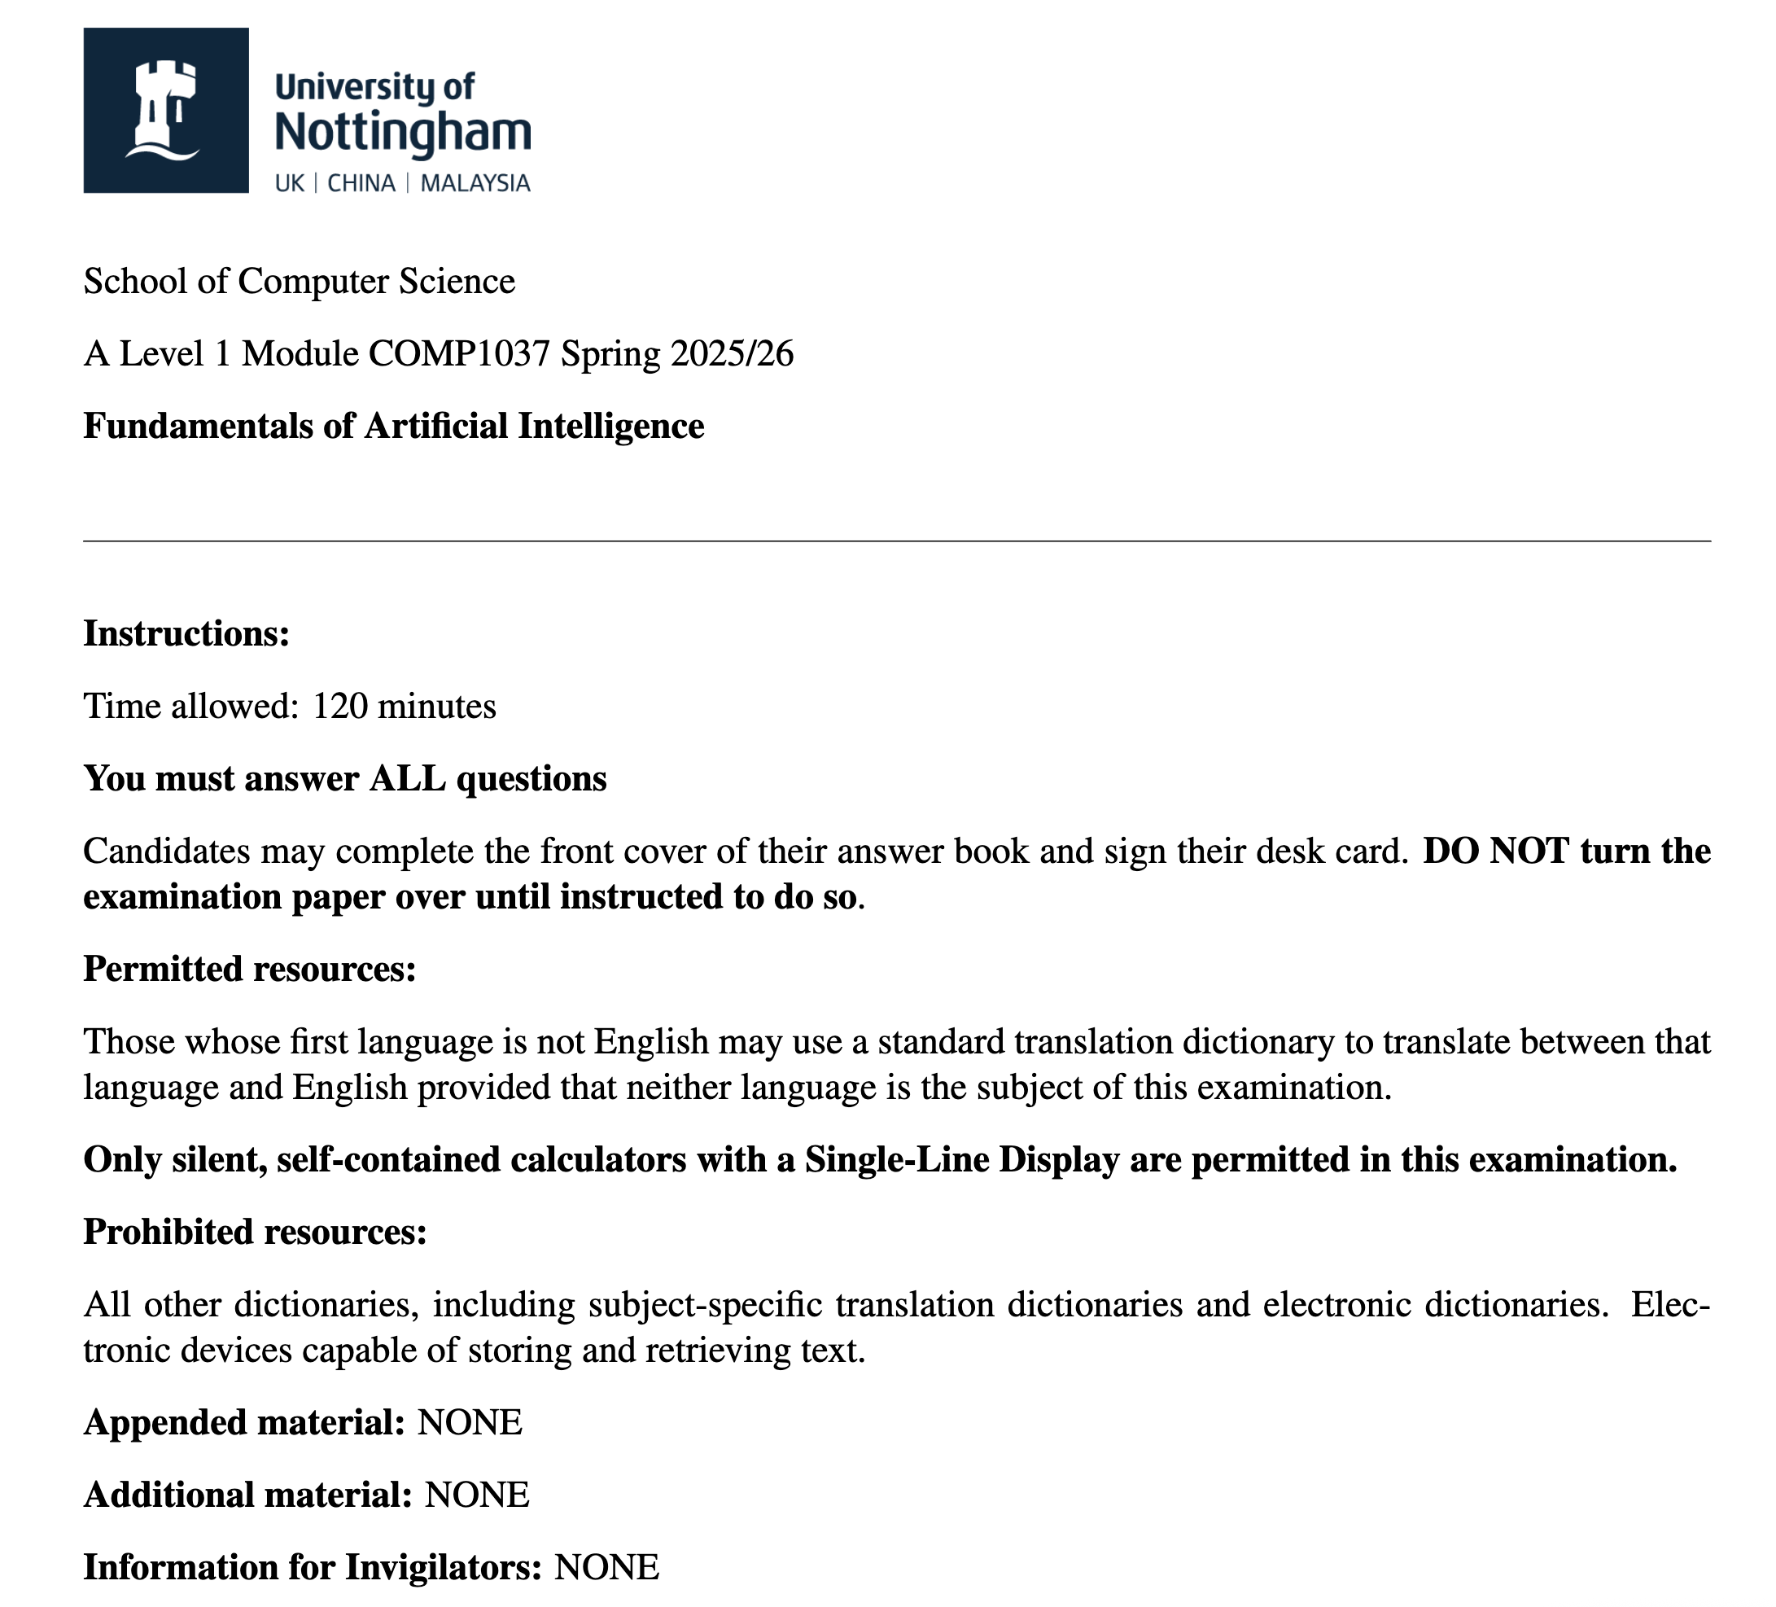

Slide 6
The Core of FAI: Agents & Environments
What is an AI agent? The agent prceive the environment, make decisions to maximize the chance of success.
The complexity of AI design depends entirely on the nature of the ENVIRONMENT.
Two basic types of environments:
Deterministic Environments: The outcome of every action is fully predictable.
Stochastic Environments: Where uncertainty exists, and the next state depends not just on the agent's action, but also on chance or probabilities.

Slide 7
Part I: Deterministic Environments
Knowledge/ Comprehension/ Application
AI basics and problem formulation
Search (uninformed, informed)
Game Playing

Slide 8
AI Basics
History of AI, definition of AI
Strong AI /Weak AI
Turing Test & Chinese Room
Basics in machine learning

Slide 9
Example Questions
[Comprehension] Briefly describe the Turing test and its objectives. Provide an example of a Turing Test in real life. Criticize Turing test by providing an example of objection. [7 Marks]
[Knowledge] In data mining, what are the relationships and difference between clustering and classification? [5 Marks]

Slide 10
problem FOMULATION & search tree
State Space
Manage a search tree to define a search problem
Evaluation criteria (Completeness, Time Complexity, Space Complexity, Optimality)
BFS, DFS, UCS, Greedy Search, A* Search
Heuristic function, Admissible, Informedness, Effective Branching Factor

Slide 11
Example Questions
[Knowledge and Comprehension] What does admissible mean? Why is it important that the heuristic used be admissible? How to evaluate two heuristic functions if both of them are admissible? [5 Marks]
[Comprehension and Application] Given the layout of 17 sticks shown in the figure, you are required to remove exactly 5 sticks in such a way that the remaining configuration forms exactly 3 squares. Given two different operators as shown below, calculate the corresponding size of the state space. [4 Marks]
Operator A: remove five sticks at a time.
Operator B: remove three squares at a time.
(Hint: Calculating the total number of distinct states an agent can possibly reach, regardless of whether those states are goal states.）

Slide 12
Game play
Components of Game Search
How is a game represented as a search problem?
Minimax Algorithm
Alpha-beta Pruning

Slide 13
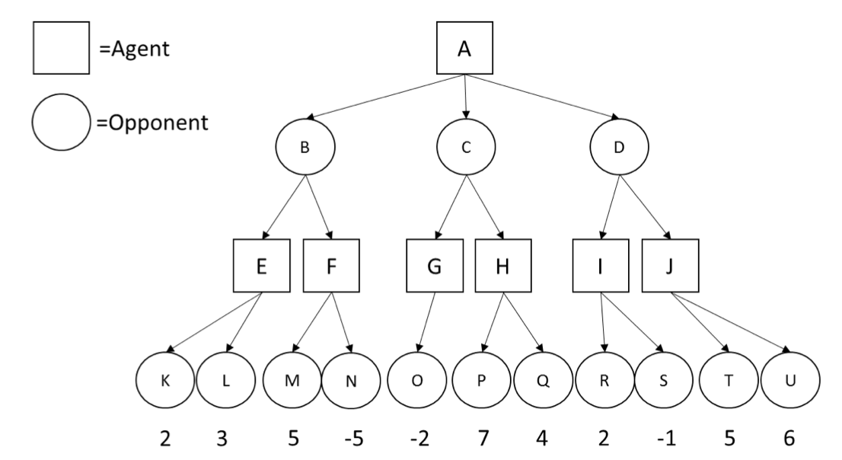
Example Questions
[Application] Given the following search tree, apply the alpha-beta pruning algorithm to it and show the search tree that would be built by this algorithm. Make sure that you show where the alpha and beta cuts are applied and which parts of the search tree are pruned as a result. Explain why the alpha and beta cuts occur. [8 Marks]

Slide 14
Part II: Stochastic Environments
Knowledge/ Comprehension/ Application
Supervised learning (Regression and Classification)
Unsupervised learning (Clustering )
Reinforcement learning (MDP , Q-learning)

Slide 15
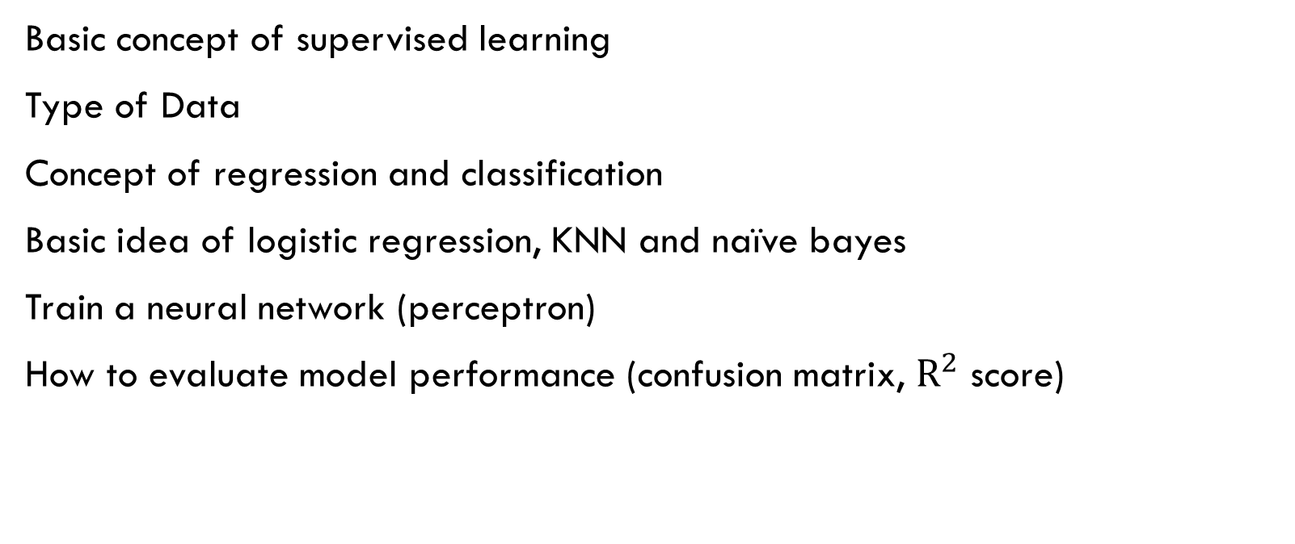
Supervised learning
Basic concept of supervised learning
Type of Data
Concept of regression and classification
Basic idea of logistic regression, KNN and naïve bayes
Train a neural network (perceptron)
How to evaluate model performance (confusion matrix, $R^{2}$ score)

Slide 16
UnSupervised learning
Basic concept of Unsupervised learning
Clustering
K-means
PCA (measure feature importance, reduce dimensionality)

Slide 17
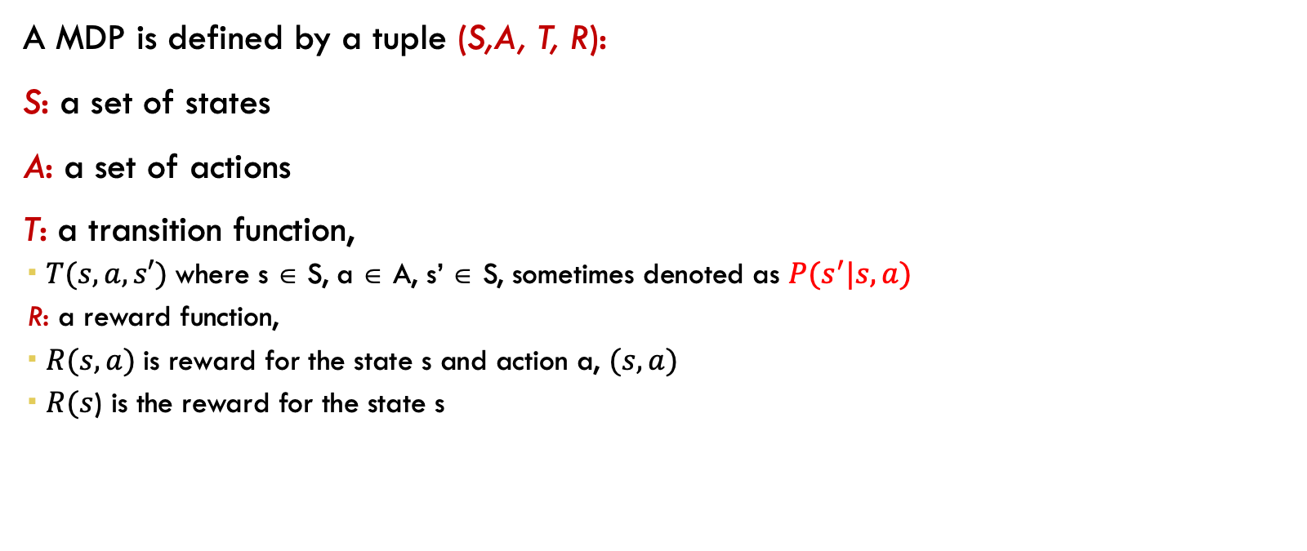
Markov Decision Process (MDP)
A MDP is defined by a tuple (S,A, T, R):
S: a set of states
A: a set of actions
T: a transition function,
$T(s,a,s′)$where s ∈ S, a ∈ A, s’ ∈ S, sometimes denoted as $P(s^{′}|s,a)$
R: a reward function,
$R(s,a)$is reward for the state s and action a, $(s,a)$
$R(s$) is the reward for the state s

Slide 18
Q-Learning
Policy
Q-table
Q-value
How to choose action
Concept of Deep Q-learning

Slide 19
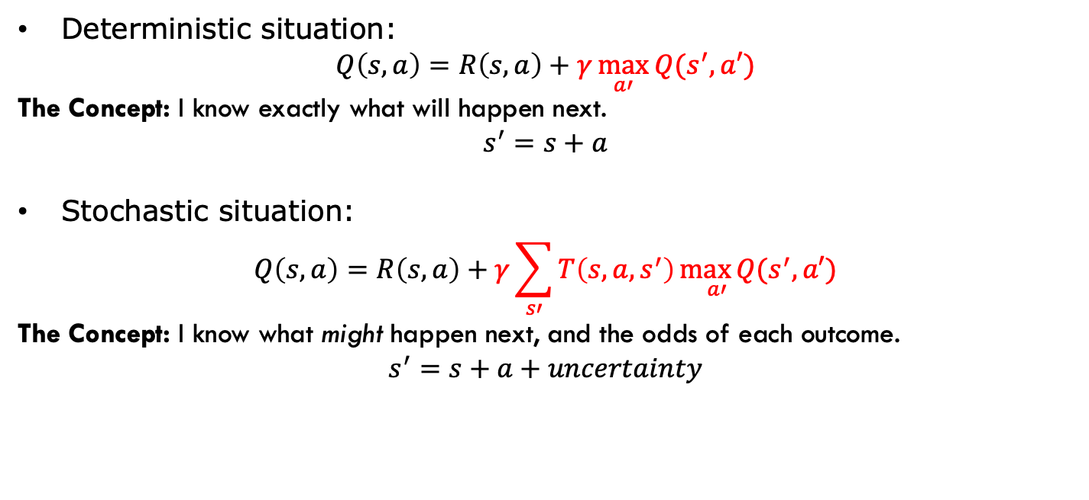
Markov Decision Process (MDP)
Deterministic situation:
$$Q\left(s,a\right)=R\left(s,a\right)+γ\max_{a′}{Q(s^{′},a′)}$$
The Concept: I know exactly what will happen next.
$$s^{′}=s+a$$
Stochastic situation:
$$Q\left(s,a\right)=R\left(s,a\right)+γ\sum_{s′}{T\left(s,a,s^{′}\right)\max_{ a′}{Q(s^{′},a′)}}$$
The Concept: I know what might happen next, and the odds of each outcome.
$$s^{′}=s+a+uncertainty$$

Slide 20
Link to AI Method
Linear Programming, Integer Programming
Heuristic Algorithm
Metaheuristics(Genetic algorithm, Simulated annealing, Tabu search)
Population Based Metaheuristics
Hyper heuristic(Reinforcement learning)

Slide 21

GOOD LUCK !!!!!!

